Slide 1
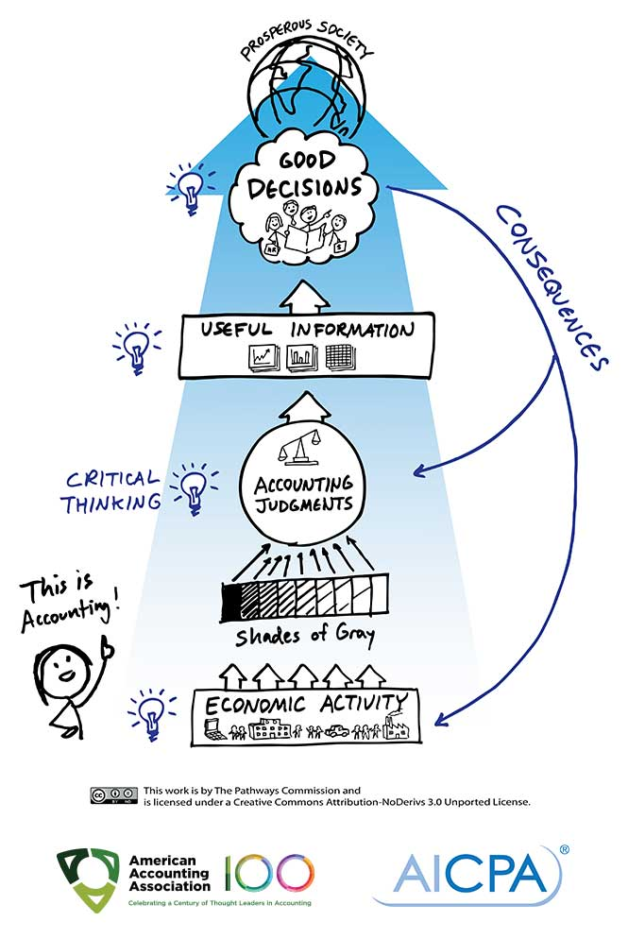

Accounting for everyone
Presented By: Milton & Sahariar
Powered By:

Slide 2
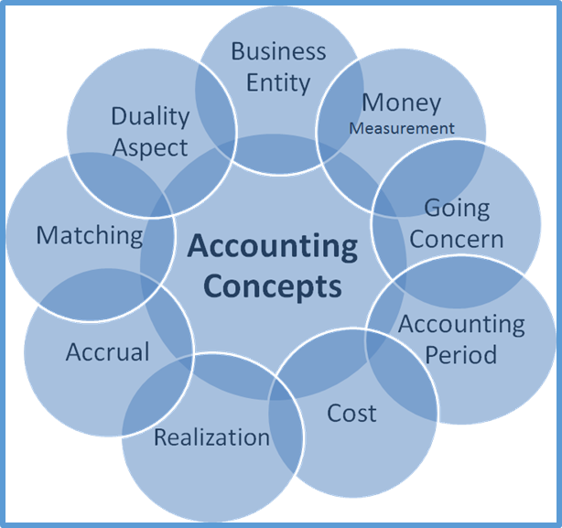
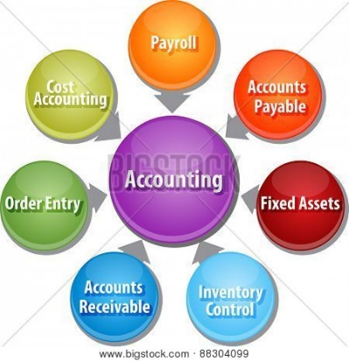
Basic Accounting concerns

Slide 3
Accounting Equation
A = L + OE;
Assets => (A)
Liabilities => (L)
Capital => (OE)
Income => (I)
Expense => (E)
A = L + (I-E);
Accounting Equation
So we can say,
OE = I-E
Total Assets = Total Liabilities
This relationship between Assets, Capital and Liabilities is called the Accounting Equation or the Balance Sheet Equation.
In general the expression, Assets = Capital + Liabilities is termed as the Accounting Equation, but you can use any of the above relationships till the time you understand the fundamentals of the equation.
Assets = Liabilities + Capital
Assets – Liabilities – Capital = 0

Slide 4
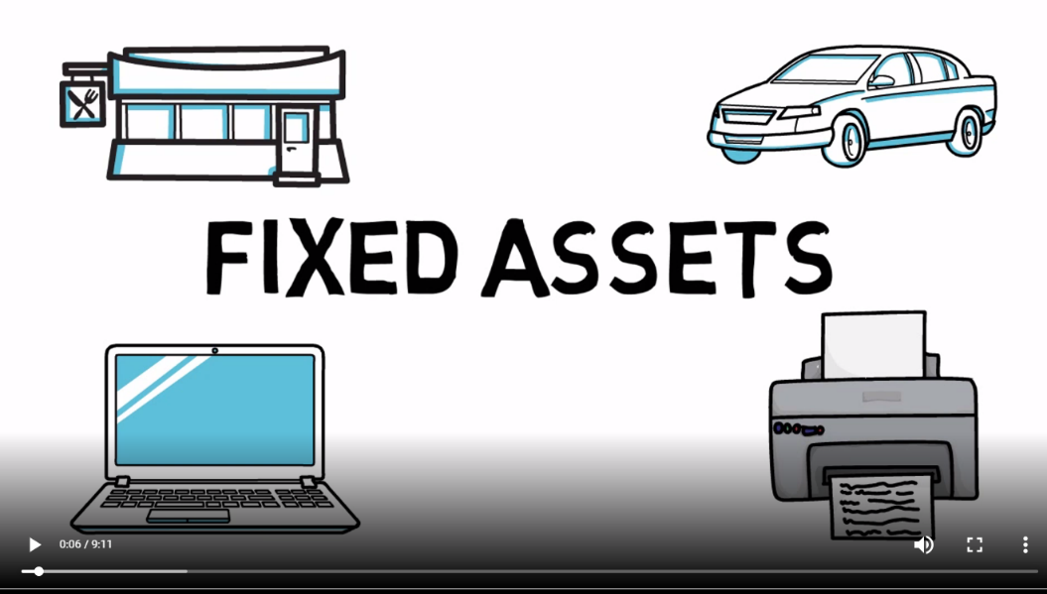
Assets
Definition: As per the accounting equation => Assets = Capital + Liabilities;
A thing, person, or a quality which is useful or beneficial is termed as an asset. In the financial world, assets are things tangible or intangible that hold an economic value and are held by businesses to extract future benefits.
Examples of assets – Cash, machinery, stock, building, vehicles, receivables, copyrights, patent, logos, patents. They can be classified as Current, Fixed, Tangible, Intangible etc.

Slide 5
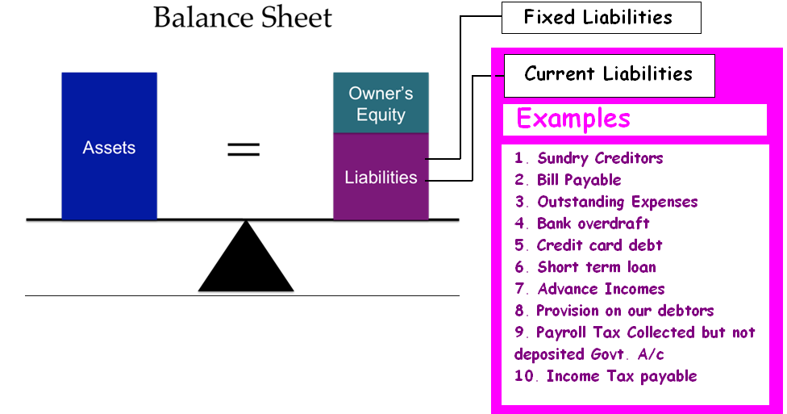
Liability
Definition: As per the accounting equation => (Capital + Liabilities) = Assets;
A liability is an obligation payable by a business to either internal (e.g., owner) or an external party (e.g., lenders). There are mainly four types of liabilities in a business; current liabilities, non-current liabilities, contingent liabilities & capital.
Types of Liabilities:
Current Liabilities
Non-current or Fixed Liabilities
Contingent liabilities
Owner’s funds/Capital/Equity

Slide 6
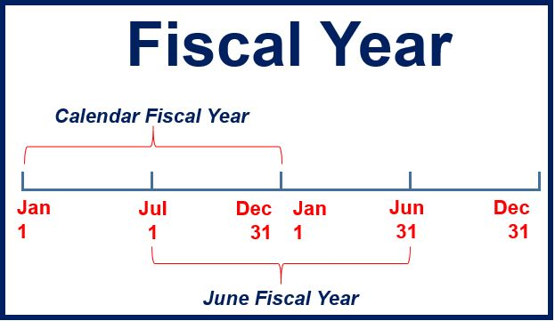
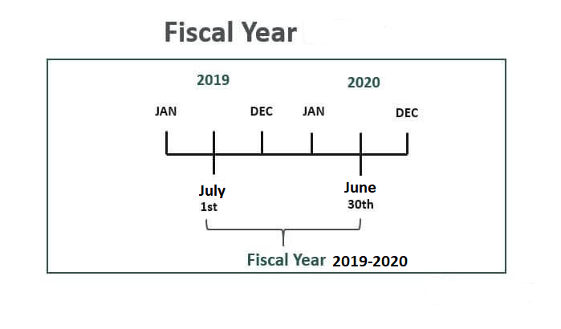
Financial Year (fy)
A Fiscal Year (FY), also known as a budget year, is a period of time used by the government and businesses for accounting purposes to formulate annual financial statements and reports. A fiscal year consists of 12 months or 52 weeks and might not end on December 31. A period that is set from January 1 to December 31 is called a calendar year.
30

Slide 7
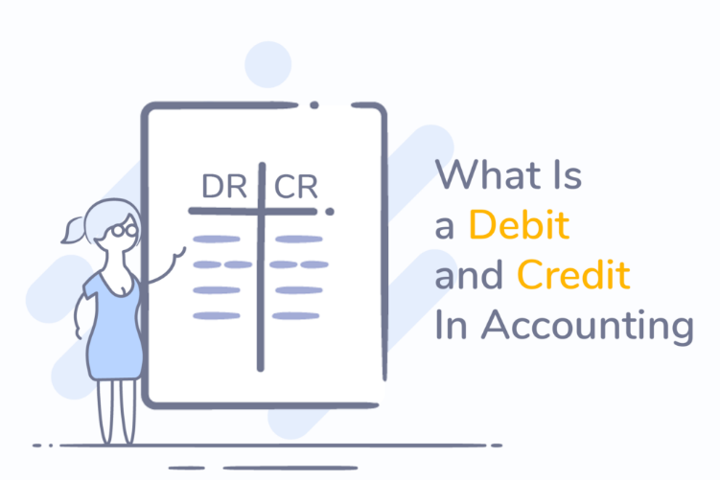
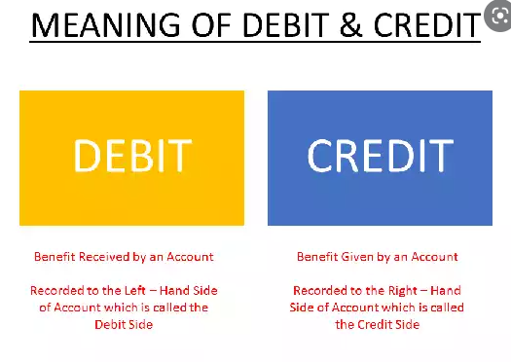

Debit & Credit
Double-entry bookkeeping, in accounting, is a system of bookkeeping so named because every entry to an account requires a corresponding and opposite entry to a different account. The double-entry has two equal and corresponding sides known as debit and credit.

Slide 8
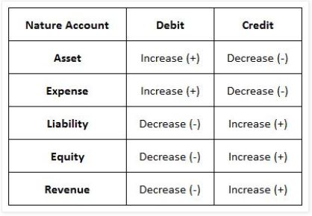
Golden Rules of Accounting
Types of Natural Accounts:
Assets Account
Expense Account
Liability Account
Owner’s Equity Account
Revenue Account

Slide 9
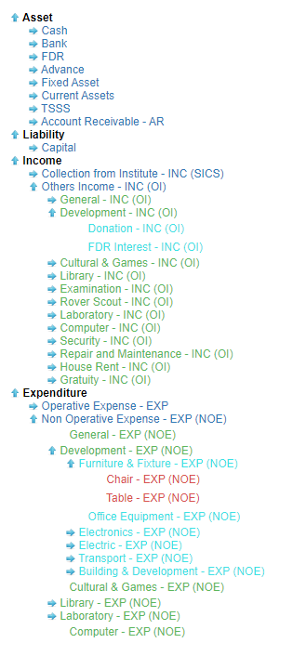
Chart of Accounts
Also known as COA, chart of accounts is a list of all accounts in a company’s general ledger. They are the identified accounts which are available for a company to record transactions.
http://194.163.152.101:82/

Slide 10
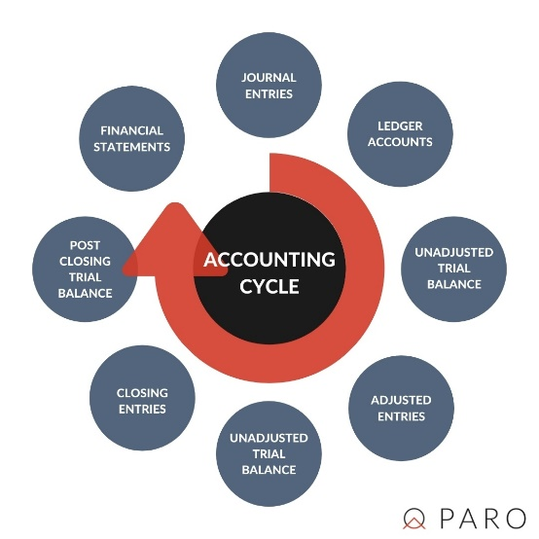
Accounting Cycle
Definition: The accounting cycle is a collective process of identifying, analyzing, and recording the accounting events of a company. It is a standard 8-step process that begins when a transaction occurs and ends with its inclusion in the financial statements.
Key TAKEAWAYS
The accounting cycle is a process designed to make financial accounting of business activities easier for business owners.
The first step in the eight-step accounting cycle is to record transactions using journal entries, ending with the eighth step of closing the books after preparing financial statements.
The accounting cycle generally comprises a year or other accounting period.
Accounting software today mostly automates the accounting cycle.

Slide 11
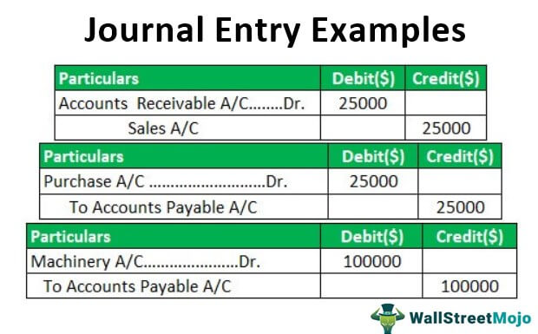
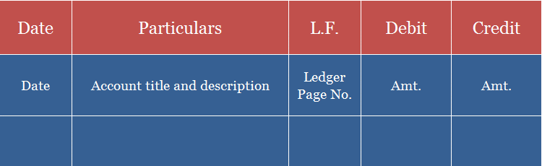
Journal is the primary book of accounting where daily records of business transactions are first recorded in chronological order. It is also called the book of original or first entry.
Recording a transaction in a journal using an accounting entry is called Journalizing. It records both the debit and credit side of a business transaction.
Journal in accounting
Product sales Mr. Xyz amount tk.25000.00
Product purchase Mr. Abc amount tk.25000.00
Purchase Machinery from Walton tk.100000.00

Slide 12
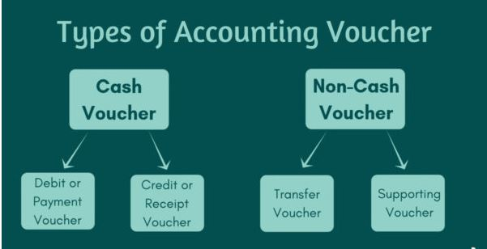
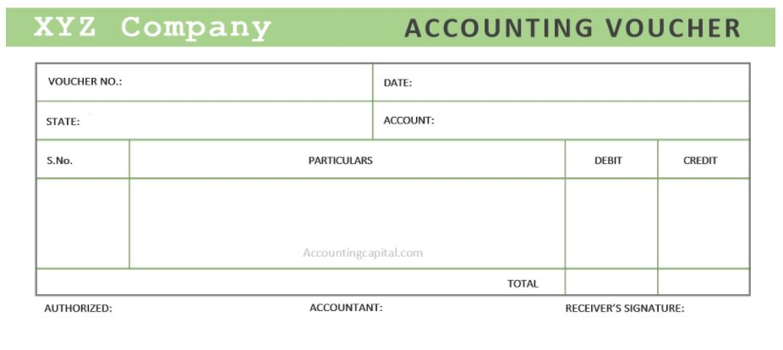
Vouchers
A document that serves as evidence for a business transaction is called a Voucher. Sometimes, mistakenly seen as just a bill or receipt; it can have many other forms.
It is not the appearance of it that matters it just needs to act as evidence of a transaction.
When a transaction is entered, the evidence of that transaction is also confirmed. A voucher helps in recording expenses or liability and further helps in its payment.

Slide 13
Ledger in accounting
It is also known as the principal book of accounts as well as the book of final entry. It is a book in which all ledger accounts and related monetary transactions are maintained in a summarized and classified form.
It is the most important book of accounting as it helps in the creation of trial balance which then acts as a base for the preparation of financial statements.
Example: An account can be either an Asset, Liability, Capital, Revenue or an Expense account. Few examples of each are Furniture, Cash, Creditors, Bank Loan, Capital, Drawings, Sales, Rent, etc.

Slide 14
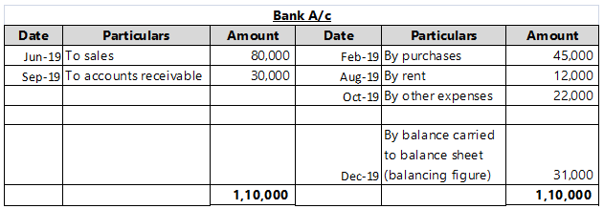
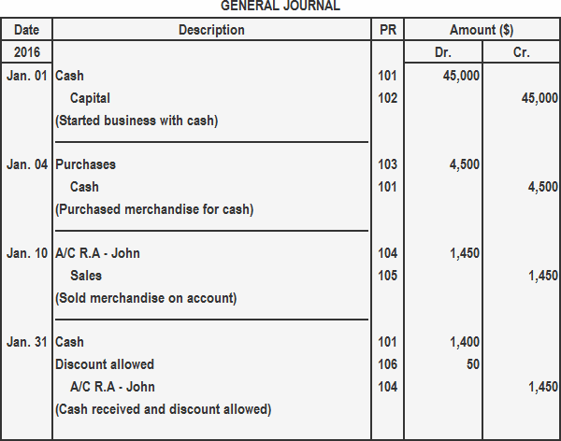
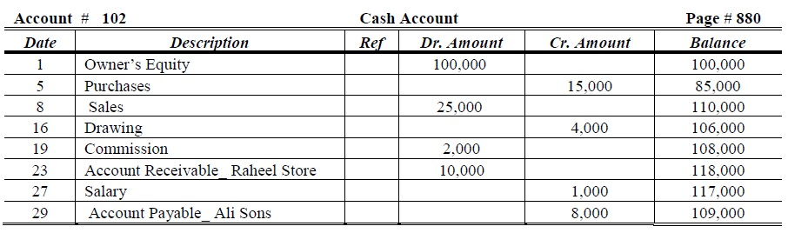
Sample Format of a Ledger Account
It is shown in “T” format and divided into 2 columns: the left-hand side represents the debit side and the right-hand side represents the credit side.
The process of transferring a transaction from a journal to a ledger account is called Posting. It is an essential task as it summarizes all transactions related to that account at one place.
Posting is made to accounts from journal entries and various subsidiary books.

Slide 15
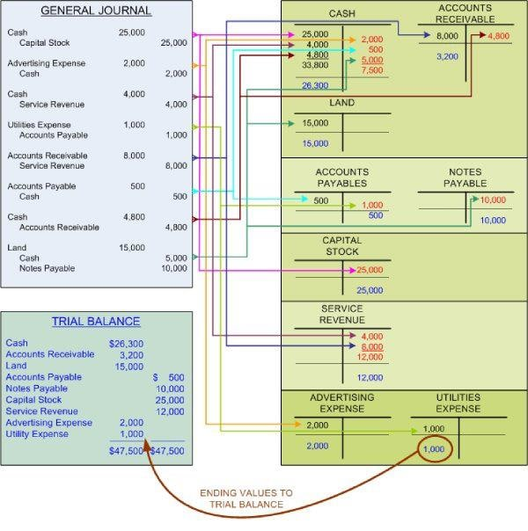

Slide 16
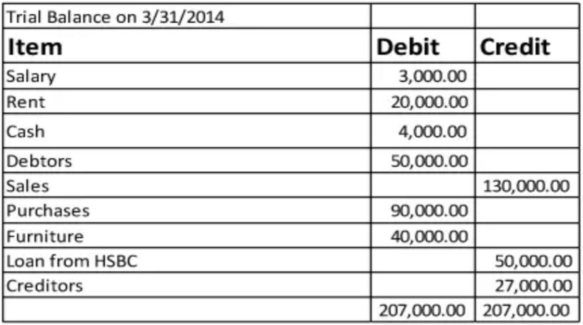
Trial Balance (Adjusted / Unadjusted)
While final accounts are being prepared at the end of an accounting period, ledger balances are also required to be updated with relevant adjustments which are a result of partial, improper and transactions which were skipped.
Examples of such transactions are depreciation, closing stock, accruals, deposits etc. Once identified adjustments are done in the ledger accounts to bring them to their appropriate levels.
Unadjusted Trial Balance
Suppose Unreal Pvt. Ltd. runs a small business and their trial balance as on March 31, 2014, is as follows:

Slide 17
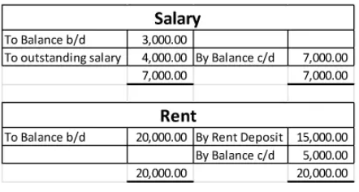
Trial Balance (Adjusted / Unadjusted)
Unadjusted Trial Balance
The following additional information is also to be incorporated in the above trial balance thereafter an adjusted trial balance is to be furnished.
The salary due to employees as on 31 March 2014 is 4,000
Rent includes a refundable deposit of 15,000
Following entries will be done in their respective ledger accounts
Hence the trial balance thus made is the one which includes all considerable adjustments and can be termed as adjusted trial balance

Slide 18
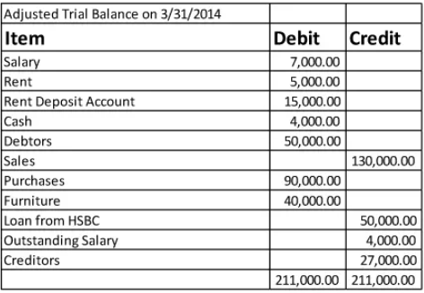
Trial Balance (Adjusted / Unadjusted)
adjusted Trial Balance

Slide 19
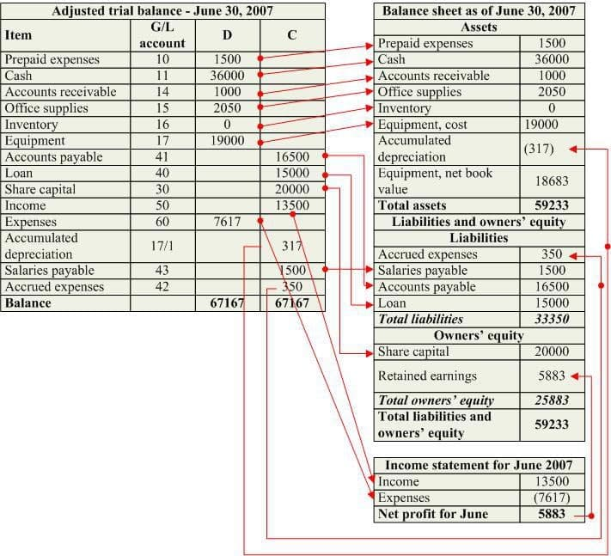
Income or Profit and Loss Statement of an Account

Slide 20
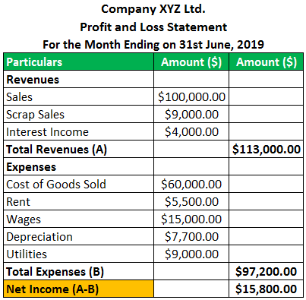
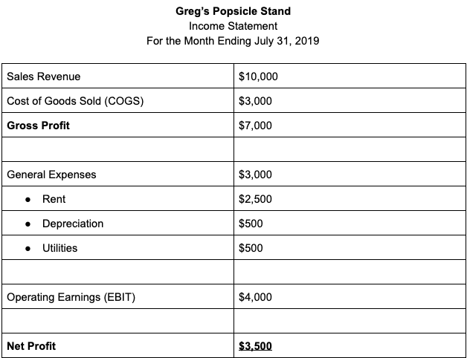
Profit and Loss Statement
Income Statement

Slide 21
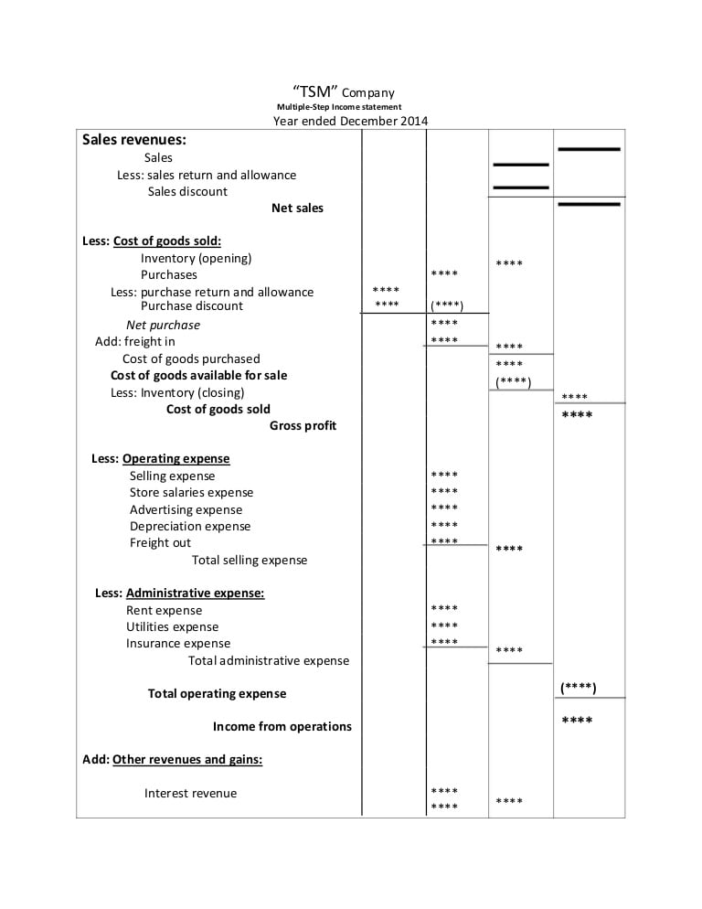

Slide 22
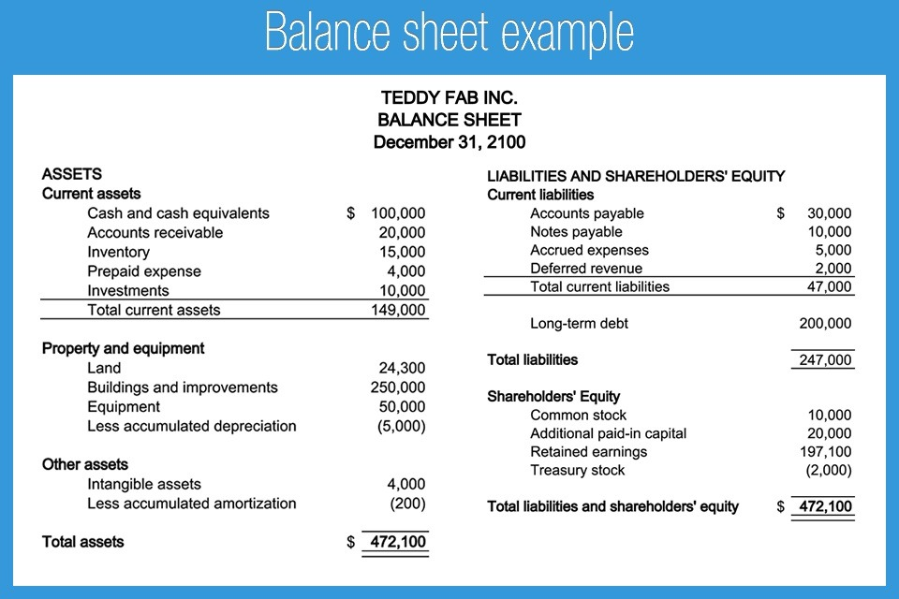

Slide 23
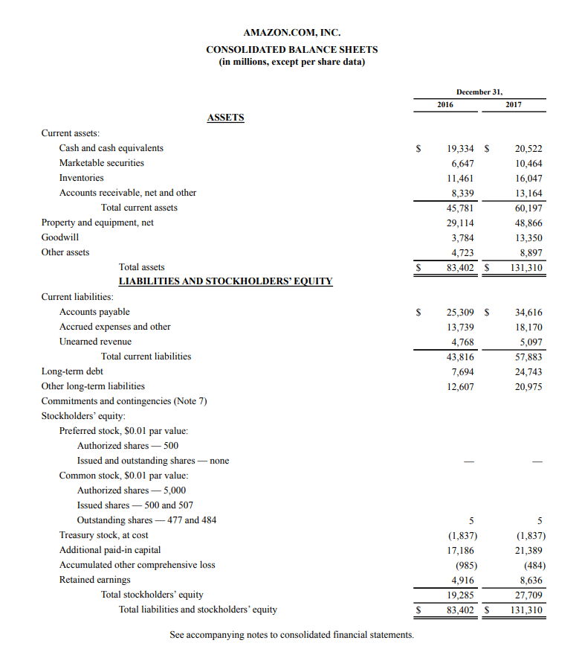

Slide 24
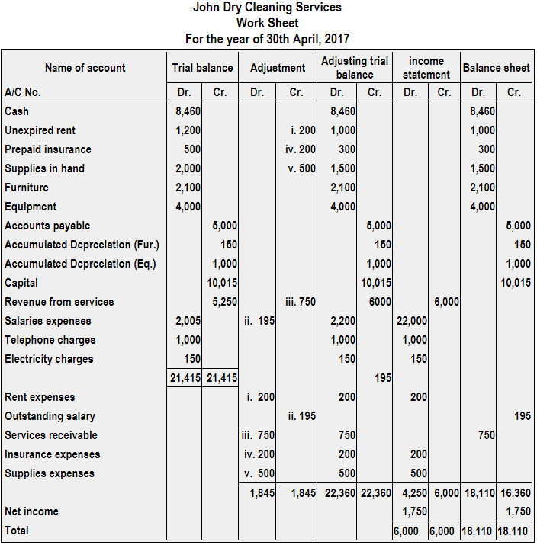
Work Sheet

